Slide 1
ClickCart
Online Shopping Application
San Min Aung
2025-02-18
1

Slide 2
Contents
1
Overview
2
Functional Features
3
Screen List & Flow
4
UI Design
5
Data Design
2

Slide 3

Overview
ClickCart is a modern mobile shopping application built with React Native, designed to provide a smooth and intuitive e-commerce experience. The app focuses on clean UI, simple navigation, and efficient product browsing, inspired by real-world retail and POS systems.
The project demonstrates core mobile app fundamentals such as authentication, product listing, category-based browsing, notifications, profile management, and checkout flow — all implemented using lightweight and scalable React Native patterns.
3

Slide 4
Functional Features
Authentication
  Simple Sign In screen with email and password inputs
  Clean and minimal login UI
Home Screen
  Promotional banner with discounts
  Category icon grid for quick access
  Popular products displayed in a 2-column grid
  Bottom tab navigation for easy screen switching
Categories
  Category selection using rounded pill-style buttons
  Clean grid layout for better readability
4

Slide 5
Functional Features
(cont.)
Notifications
  Order status updates (confirmed, processing, etc.)
  Simple list-based notification system with details action
Profile
  User profile with avatar
  Display of personal information (name, phone, email)
  Edit profile option
Checkout
  Shipping, delivery, payment, and promo sections
  Item list with quantity and price
  Automatic subtotal, tax, and total calculation
  “Place Order” action button
5

Slide 6
Screen List & Flow
  Login Screen
  Home Screen
  Categories Screen
  Products browsing Screen
  Notifications Screen
  Profile Screen
  Checkout Screen
6

Slide 7
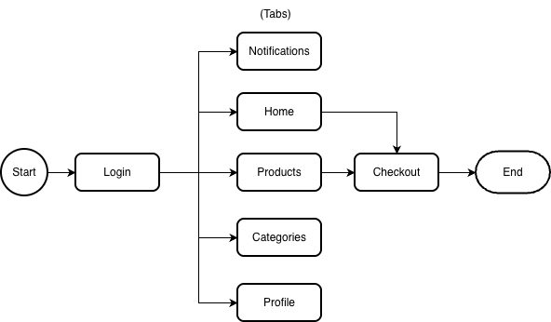
System FLow Diagram
7

Slide 8
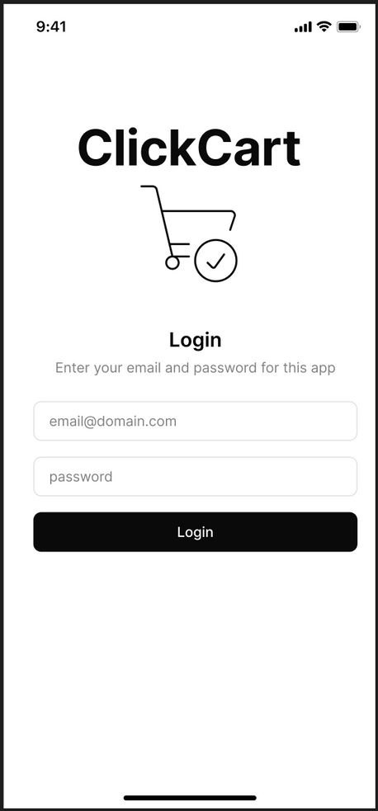
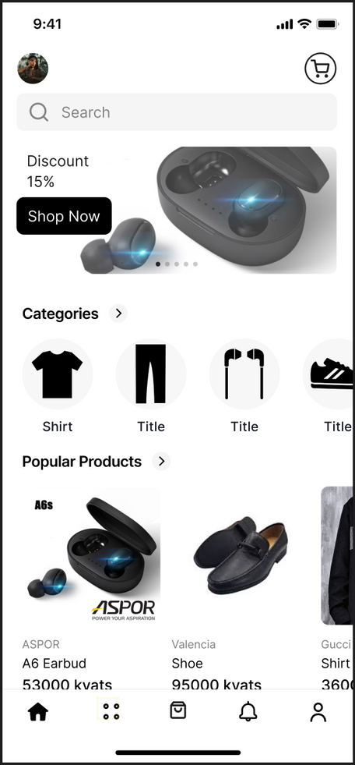
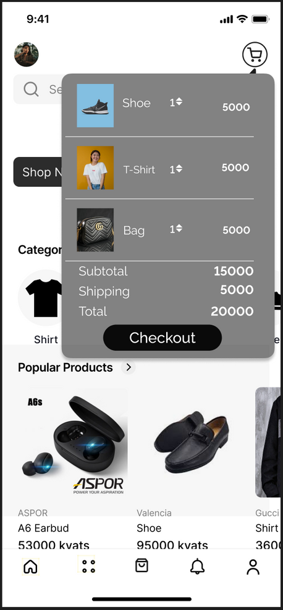
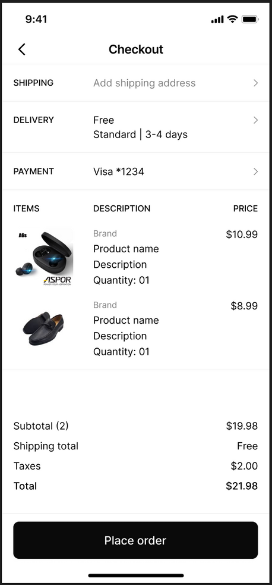
UI Design
Login Screen
Home Screen
Cart modal
Checkout Screen
Pop up when clicked
Successful
Checkout modal
8

Slide 9
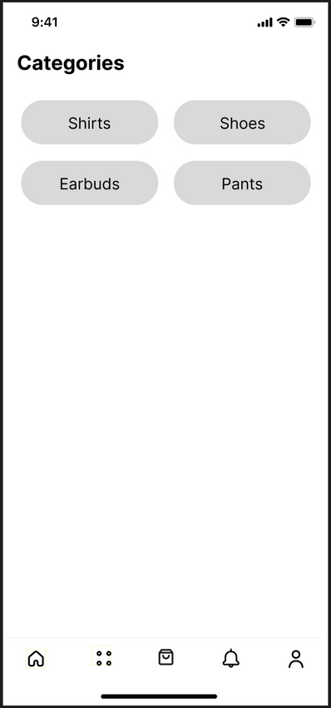
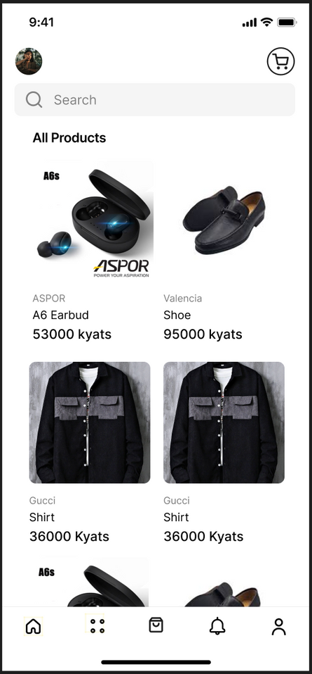
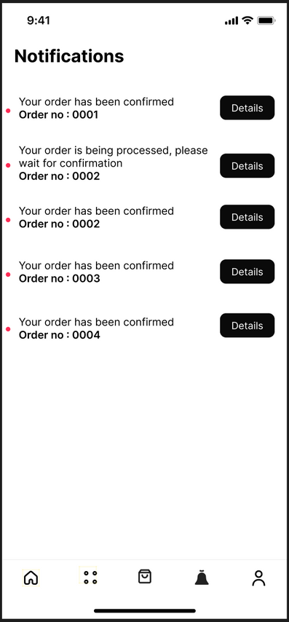
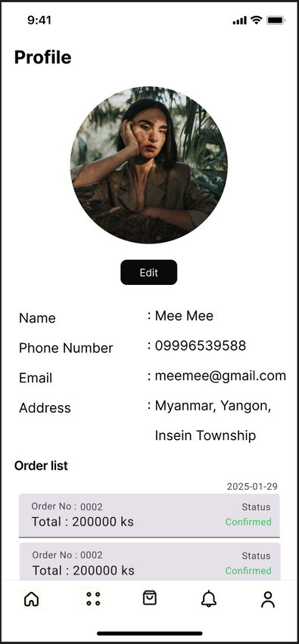

UI Design
(cont.)
Categories Screen
Products Screen
Notifications Screen
Profile Screen
9

Slide 10
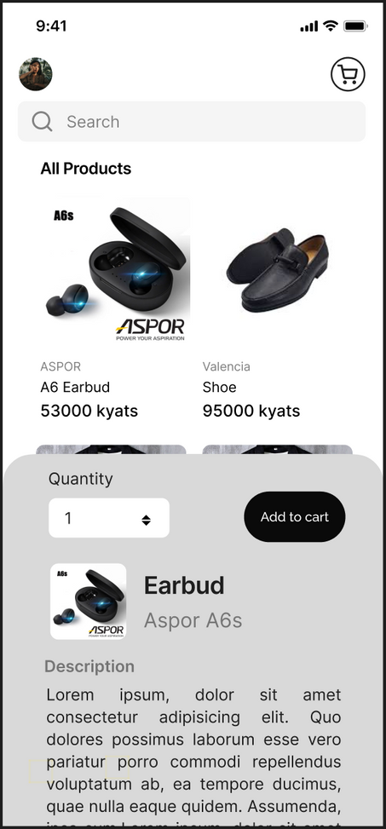
UI Design
(cont.)
Click an item and model pop up
10

Slide 11
Data Design
Data Format - Json
Data objects - Users, Categories, Products
Users
Categories
{
"users": [
{
"id": 1,
"name": "Mee Mee",
"email": "meemee@gmail.com",
"password": "hashed_password_here",
"phone": "09996539588",
"profileImage": "url_or_local_path_to_image"
}
]
}
{
"categories": [
{ "id": 1, "name": "Shirts" },
{ "id": 2, "name": "Shoes" },
{ "id": 3, "name": "Earbuds" },
{ "id": 4, "name": "Pants" }
]
}
11

Slide 12
Data Design
(cont.)
Products
{
"products": [
{
"id": 101,
"name": "A6 Earbud",
"category": "Earbuds",
"brand": "ASPOR",
"description": "High-quality wireless earbuds",
"price": 10.99,
"image": "url_or_local_path",
"discount": 15,
"stock": 50
},
{
"id": 102,
"name": "Valencia Shoe",
"category": "Shoes",
"brand": "Valencia",
"description": "Comfortable everyday shoe",
"price": 95.00,
"image": "url_or_local_path",
"discount": 0,
"stock": 100
}
]
}
12

Slide 13
THANK YOU
13

